Slide 1
American sign language RECOGNITIOn
Sundar Balamurugan

Slide 2
Motivation
Sign Language is widely used by 250,000 to 500,000 people around the world [6].
It is very difficult for people to understand sign language if they are not familiar with it.
The aim is to help the people to recognize alphabets using hand gestures.

Slide 3
Dataset
The dataset required for the experimental study of the proposed algorithm has been created using mediapipe open source library.
The mediapipe hand tracking library has around 21 key features in hand and it is used to generate the dataset.
The generated dataset contains all the 26 alphabets with hand gestures.
It captures the hand gestures for 30 frames.
The dataset has 30 different permutations for each alphabet.
The same dataset is collected from four different humans.
2 male
1 female
1 kid
As a total the dataset contains 93,600 values.
The dataset has different parameters that are time, values(x,y,z) of hand joints.
The dataset is divided into 90% for Training and 10% for Testing.

Slide 4
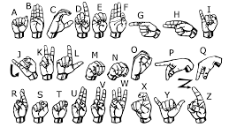
American Alphabet hand gestures

Slide 5
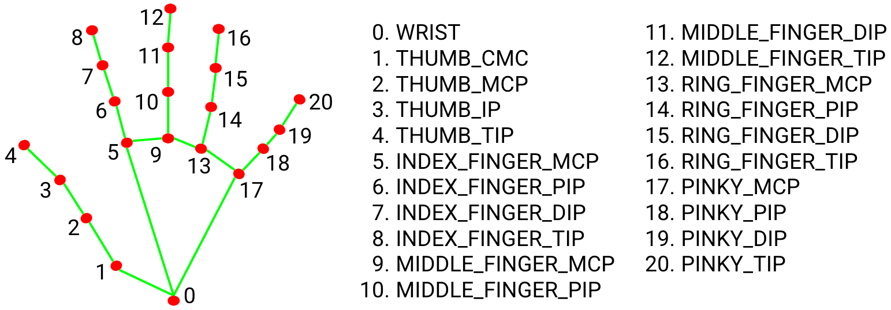
Mediapipe- Open source Library
Mediapipe is an opensource , high fidelity and finger tracking solution.
Mediapipe uses Palm detection model to get the hand bounding box.
A hand landmark detection over the palm detector and returns high-fidelity 3D hand keypoints.
It returns the accurately cropped image of the hand.
From the image you can find the 21 different key points that can be tracked by mediapipe.

Slide 6
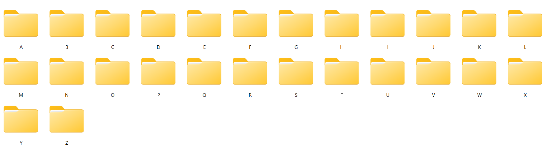
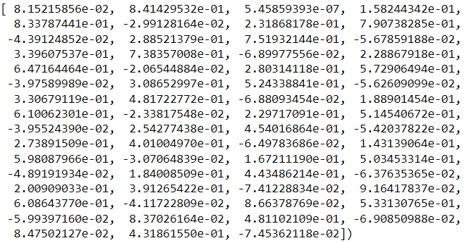
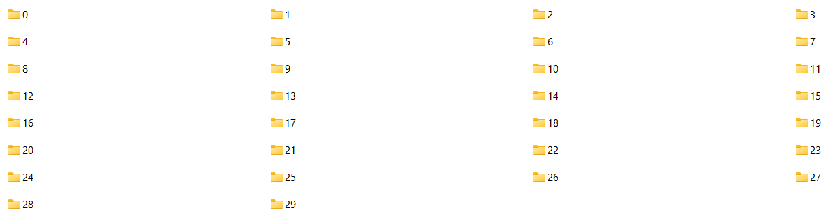
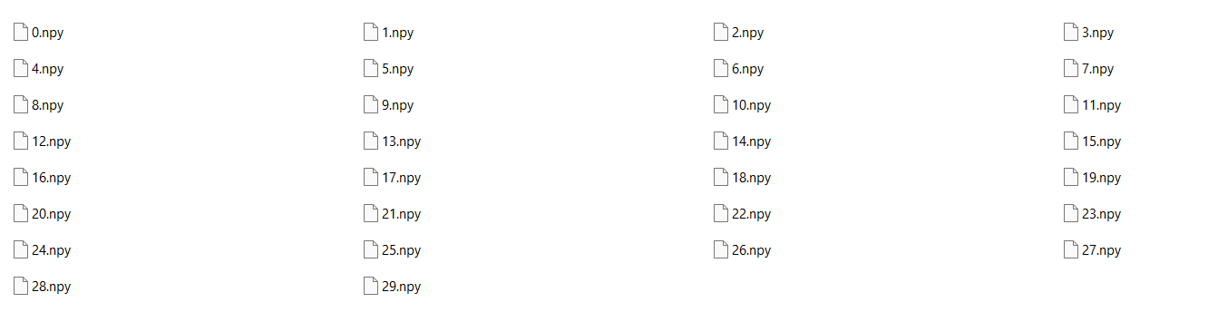
Images from the dataset

Slide 7
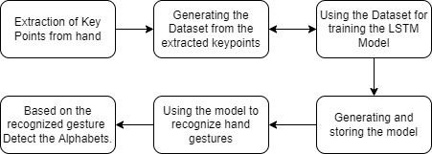
Architecture

Slide 8
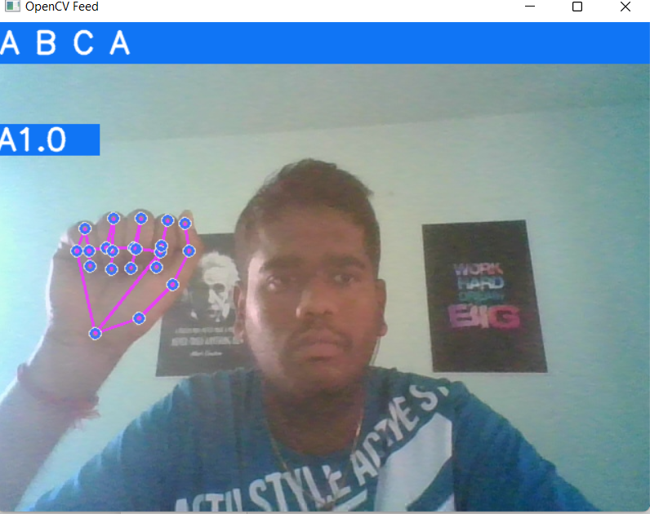
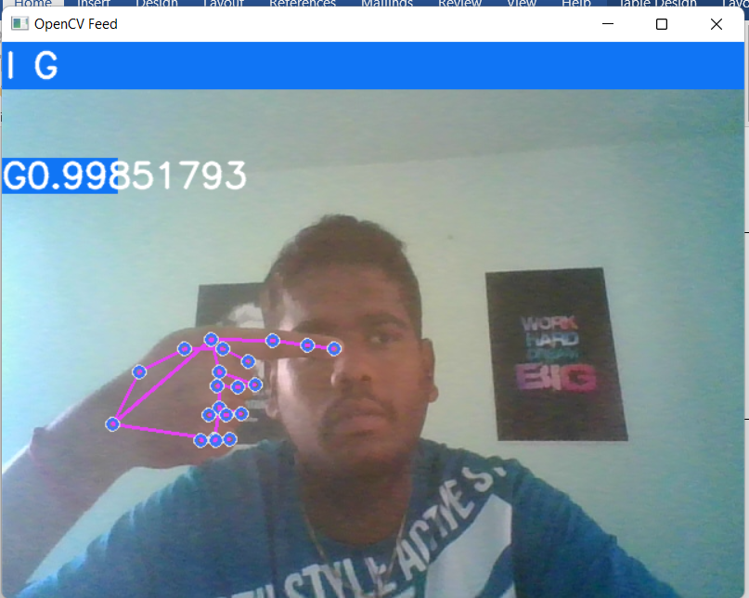
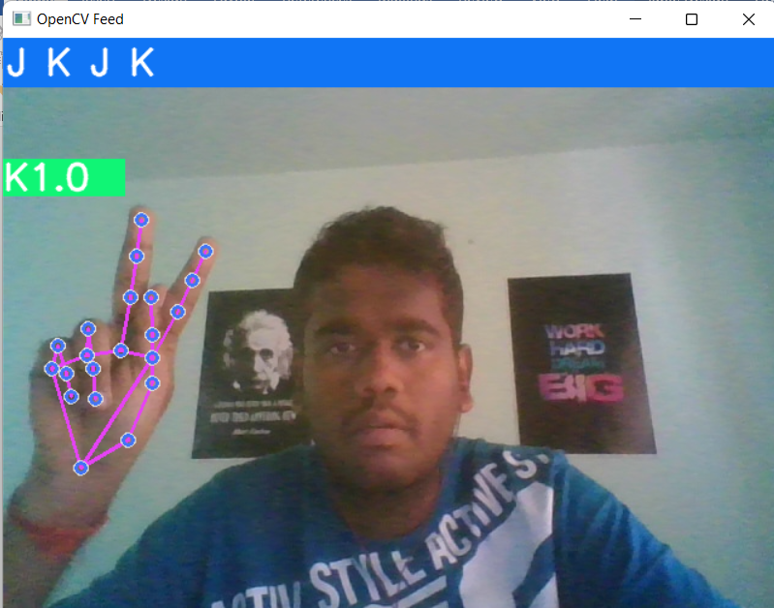
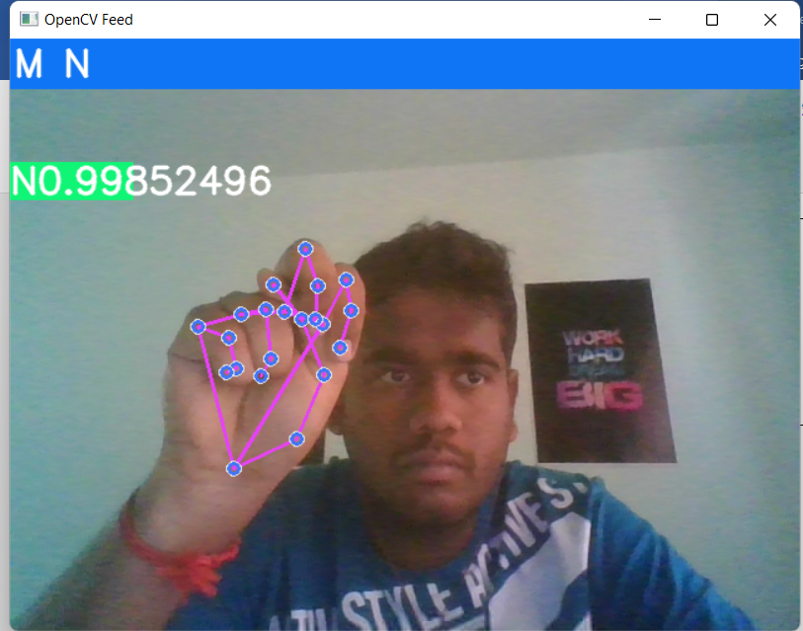
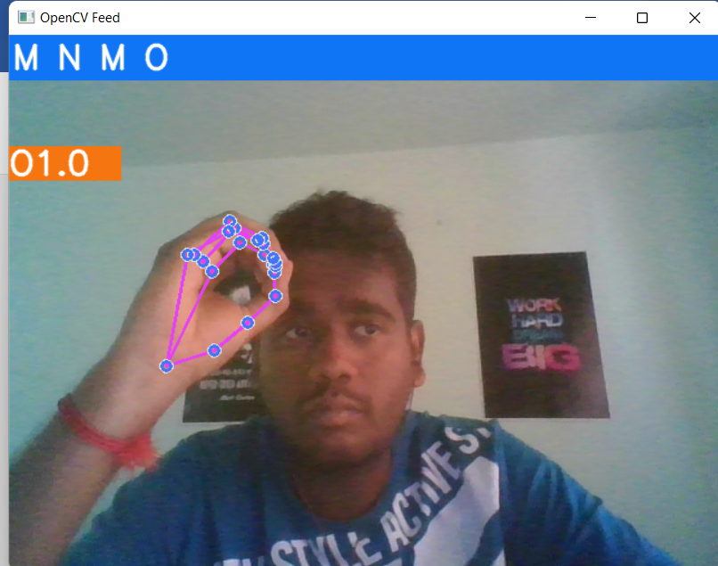
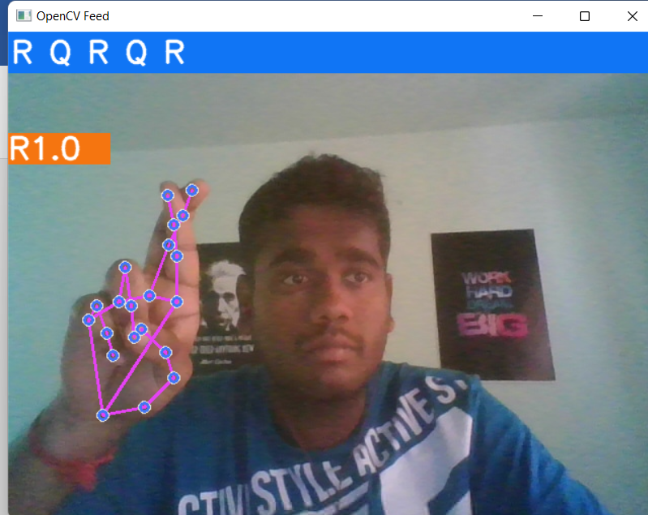
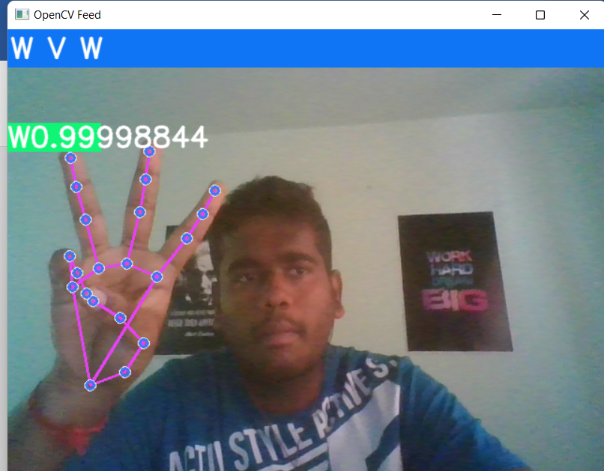
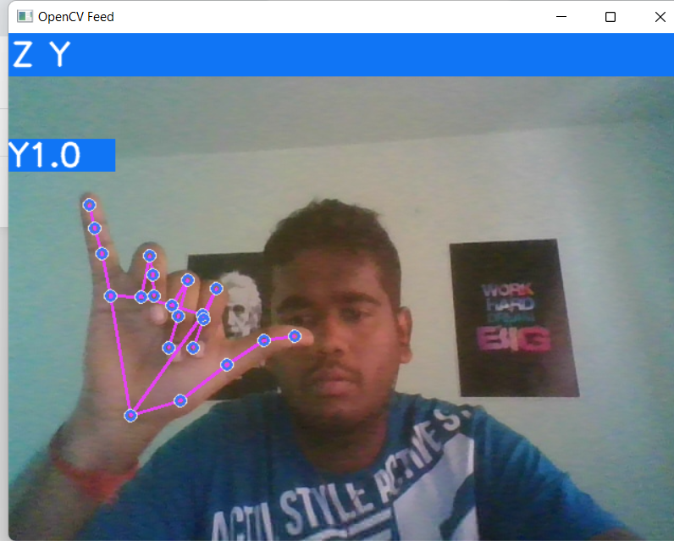
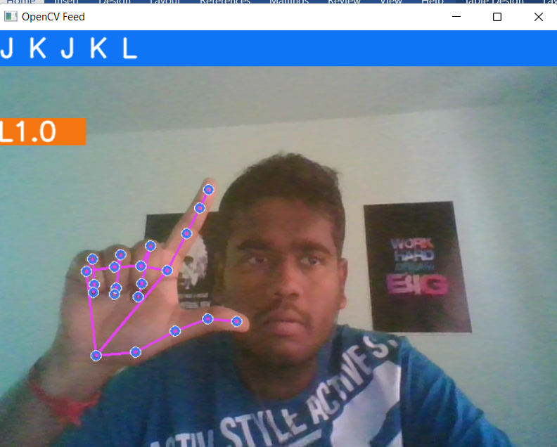
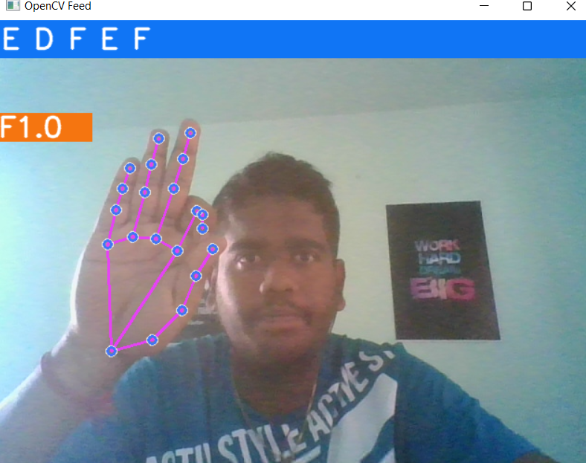
Results

Slide 9


